Slide 1
Weekly meeting 31/03

Slide 2

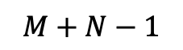
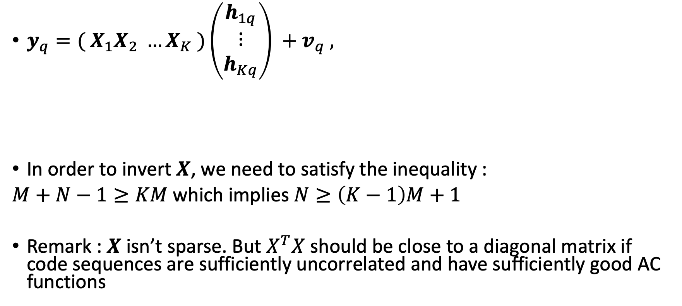


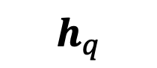
Improvements on Signal separation
$$M$$
$$X_{k}= \left[\begin{matrix}\begin{matrix}x_{k}\left(0\right) \\ x_{k}\left(1\right)\end{matrix} & \begin{matrix}\begin{aligned} \\ 0\end{aligned} \\ \begin{matrix}x_{k}\left(0\right) \\ x_{k}\left(1\right)\end{matrix}\end{matrix} & \begin{matrix}\begin{matrix}0\begin{matrix} & 0\end{matrix} \\ 0\begin{matrix} & 0\end{matrix}\end{matrix} & \begin{matrix} \\ \end{matrix}\end{matrix} \\ ⋮ & ⋮ & ⋮ \\ \begin{matrix}x_{k}\left(N−1\right) \\ \begin{matrix}0 \\ \begin{matrix}⋮ \\ 0\end{matrix}\end{matrix}\end{matrix} & \begin{matrix}x_{k}\left(N−1\right) \\ \begin{matrix}0 \\ \begin{matrix}⋮ \\ 0\end{matrix}\end{matrix}\end{matrix} & \begin{matrix}\begin{matrix}⋱ & \begin{matrix}x_{k}\left(0\right) \\ x_{k}\left(1\right)\end{matrix}\end{matrix} \\ \begin{matrix}\begin{matrix} & ⋮\end{matrix} \\ \begin{matrix} & x_{k}\left(N−1\right)\end{matrix}\end{matrix}\end{matrix}\end{matrix}\right]$$
$y_{q}={( X}_{1}X_{2} …X_{K} )\left(\begin{matrix}h_{1q} \\ ⋮ \\ h_{Kq}\end{matrix}\right) +v_{q} ,$
In order to invert $X$, we need to satisfy the inequality :
$M+N−1≥KM$ which implies $N≥\left(K−1\right)M+1$
Remark : $X$ isn’t sparse. But $X^{T}X$ should be close to a diagonal matrix if code sequences are sufficiently uncorrelated and have sufficiently good AC functions
$$X$$
$$h_{q}$$
$$M+N−1$$

Slide 3
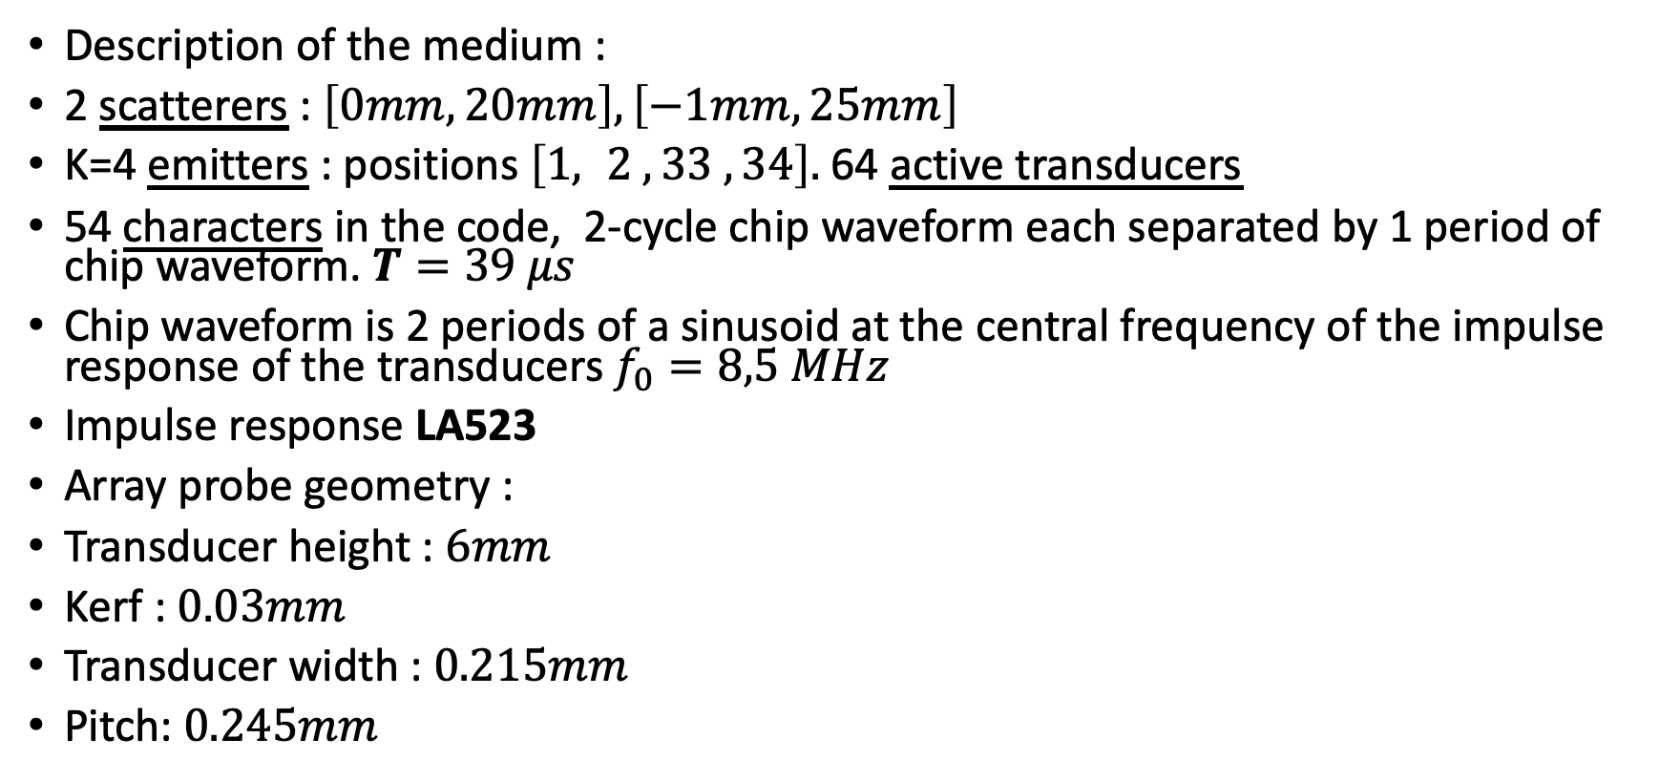
Improvements on Signal separation
Description of the medium :
2 scatterers : $\left[0mm,20mm\right],\left[−1mm,25mm\right]$
K=4 emitters : positions $\left[1, 2 , 33 , 34\right].$64 active transducers
54 characters in the code, 2-cycle chip waveform each separated by 1 period of chip waveform. $T=39 μs$
Chip waveform is 2 periods of a sinusoid at the central frequency of the impulse response of the transducers $f_{0}=8,5 MHz$
Impulse response LA523
Array probe geometry :
Transducer height : $6mm$
Kerf : $0.03mm$
Transducer width : $0.215mm$
Pitch: $0.245mm$

Slide 4
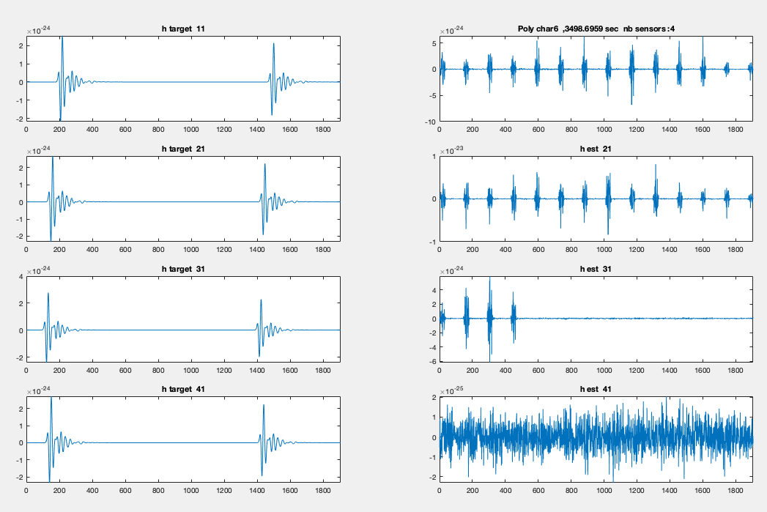

Improvements on Signal separation
Under determined system : $N≥\left(K−1\right)M+1$ not verified : 2 scatterers, K=4 emitters
Scattering functions of an underdeterminated system of equations : tragets and estimations

Slide 5
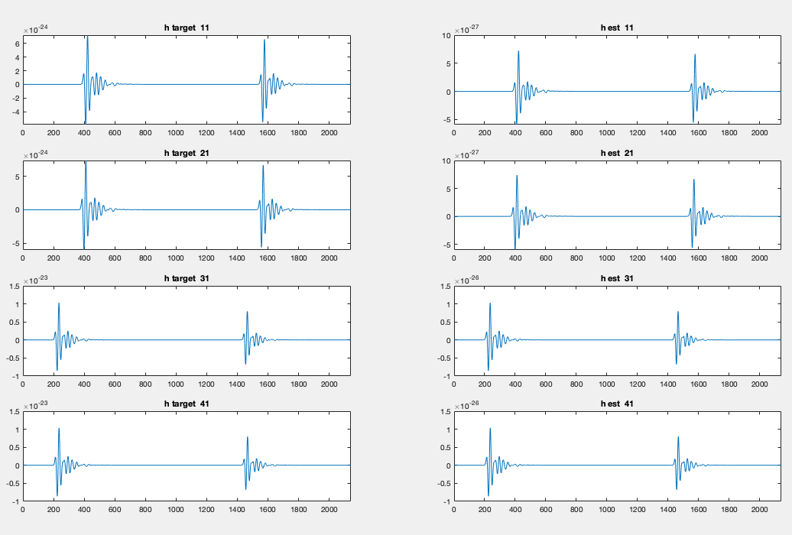
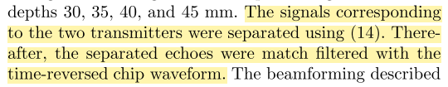
Improvements on Signal separation
Separation performence
On the shape of the scattering
Function
Way of comparaison Jensen
and Gran :
«
»
Scattering functions : tragets and estimations

Slide 6
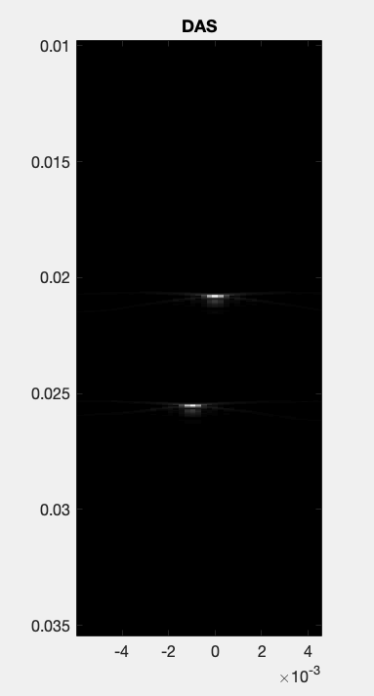
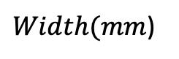
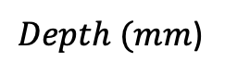
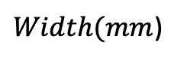
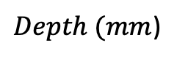
Improvements on Signal separation
$Depth (mm$)
$Depth (mm$)
Beamforming
$Width(mm$)
$Width(mm$)

Slide 7

Improvements on Signal separation
When the the simulation is done without noise (as previsously), the method should find th exact scattering function but the simulation tool is fully linear.
Performence under the
influence of noise :
2 scatterers $\left[0mm,20mm\right]$
$\left[−1mm,22mm\right]$
same probe
characteristics
Noise-free simulation
One period between eeach signal carrier
Twice as much symbols (same size)

Slide 8
Beamforming under the influence of noise
45 dB noise added.

Slide 9
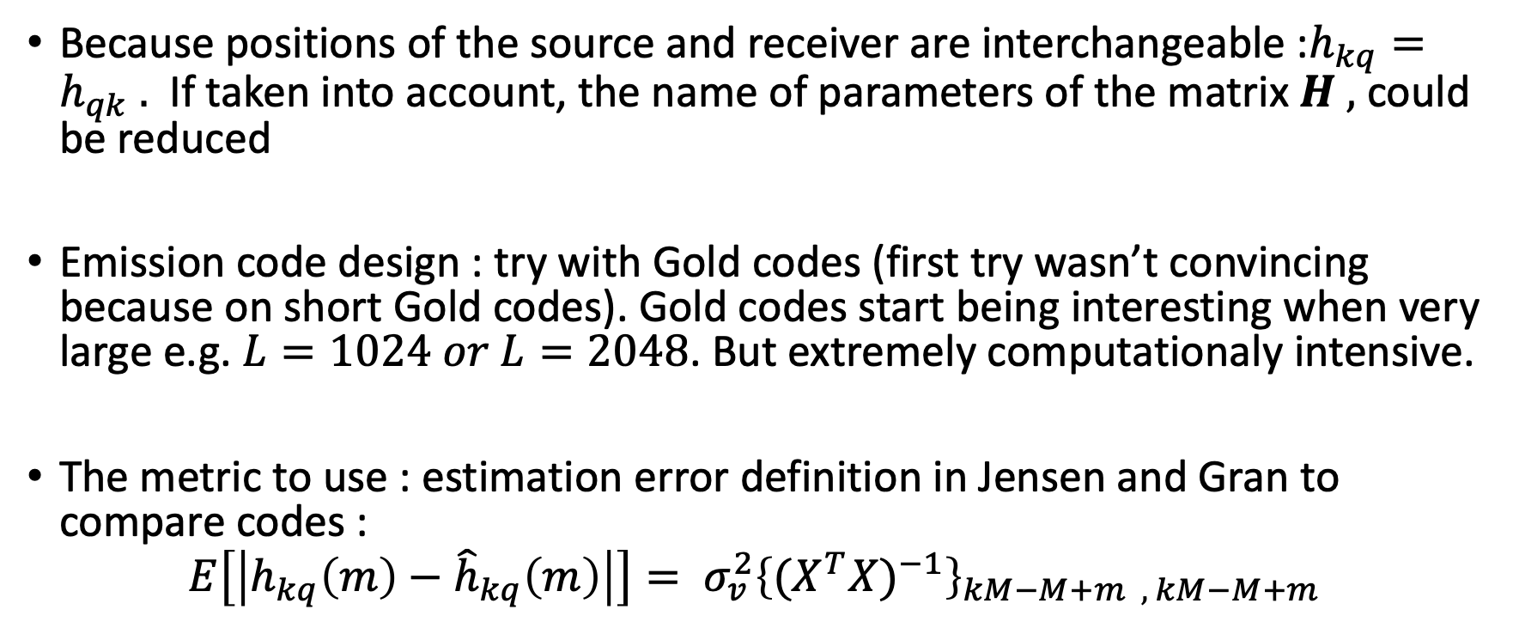
Improvements to add to the method
Because positions of the source and receiver are interchangeable :$h_{kq}=h_{qk} .$ If taken into account, the name of parameters of the matrix $H ,$ could be reduced
Emission code design : try with Gold codes (first try wasn’t convincing because on short Gold codes). Gold codes start being interesting when very large e.g. $L=1024 or L=2048$. But extremely computationaly intensive.
The metric to use : estimation error definition in Jensen and Gran to compare codes :
$$E\left[\left|h_{kq}\left(m\right)−{\hat{h}}_{kq}\left(m\right)\right|\right]= σ_{v}^{2}{\left\{{(X^{T}X)}^{−1}\right\}}_{kM−M+m , kM−M+m}$$

Slide 10
Learning method
Implemented the training dataset by saving both the observation on a q-th transducer and the contribution of each emission separately. Done by exciting each of the emitting transducers separately and recording the observed echoes.

Slide 11
